Slide 1

Wireless Networking
Ambuj Varshney
ambujv@nus.edu.sg
Notes:
++ Thank you for inviting me to give this talk
++ In this talk, I will present a pathway that can enable us to make wireless embedded systems ubiquitous. I will describe my previous research efforts that tackle the critical challenges that limit the growth of wireless embedded systems. These are related to the growing energy asymmetry that exists between sensing, computation and communication blocks on these platforms.
++ Finally, I will conclude my talk by covering the research agenda that I would like to work on as a faculty member.

Slide 2
Wireless Basics, Microcontrollers, Contiki and Battery lifespan
Notes:
++ Over the past few years, I have designed several backscatter and beyond backscatter systems that precisely overcome these critical challenges that have limited the widespread deployment of backscatter on IoT devices.
++ The research vision that I have pursued and would like to pursue as a faculty member is to enable a massive deployment of IoT devices by bridging the energy asymmetry between sensing, computation and communication blocks by designing novel platforms and communication mechanisms. I am going to describe some of my research contributions next.

Slide 3
Course Administration
Notes:
++ Over the past few years, I have designed several backscatter and beyond backscatter systems that precisely overcome these critical challenges that have limited the widespread deployment of backscatter on IoT devices.
++ The research vision that I have pursued and would like to pursue as a faculty member is to enable a massive deployment of IoT devices by bridging the energy asymmetry between sensing, computation and communication blocks by designing novel platforms and communication mechanisms. I am going to describe some of my research contributions next.

Slide 4
How would the student’s performance be graded
Component | Weightage to Overall Grade
Project (group) | 20 %
Assignment 1 (group) | 5 %
Assignment 2 (group) | 10 %
Assignment 3 (group) | 15 %
Tutorial | 10 %
Final assessment | 40 %

Slide 5
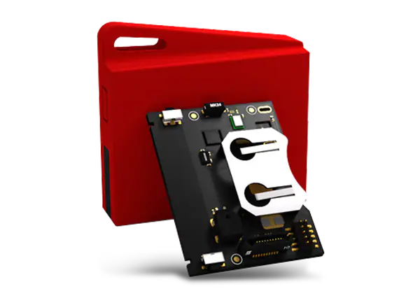
Group formation, sensor tags
Sensor tag and Programmer: A wireless embedded device
May be able to lend additional sensor tags for some groups
Some groups have not yet collected sensor tag!
Any other issues with sensor tag? Faulty?
Notes:
++ We may all have heard of the term Internet of Things. So how are these wireless embedded systems related to the Internet of Things: Today, IoT includes a broad class of devices, including powerful platforms such as smartphones. However, it also includes more resource-constrained devices and what we call Wireless Embedded Systems, and in fact, I consider it to be one of the essential parts of the IoT ecosystem.
++ These are platforms equipped with a radio transceiver, sensor, microcontroller, and some form of energy storage. These platforms also often form a network, and sensor network as it is called has been an active area of research for the past two decades.
++ The research community has also developed wireless embedded platforms which we may know about, and these include: CMUCAM, which is an image sensor platform developed at Carnegie Mellon University, or Permamote is long life sensor platform from the lab I am associated with at UC Berkeley or Lorea which is a long-range backscatter platform that I had developed as part of my doctoral dissertation at Uppsala University. All of these are an example of Wireless Embedded Systems.

Slide 6
Assignment 1 and 2
Assignment 1: Some groups have already demonstrated! Kudos!
Any issues with sensor tag?
Deadline: Tutorial session 4 and 5.
Assignment 1: Print the name of group members
Any group member can demonstrate during the tutorial session
Assignment 2: Release details over the weekend
Deadline: mid of march
Statement of work for group members
Notes:
++ We may all have heard of the term Internet of Things. So how are these wireless embedded systems related to the Internet of Things: Today, IoT includes a broad class of devices, including powerful platforms such as smartphones. However, it also includes more resource-constrained devices and what we call Wireless Embedded Systems, and in fact, I consider it to be one of the essential parts of the IoT ecosystem.
++ These are platforms equipped with a radio transceiver, sensor, microcontroller, and some form of energy storage. These platforms also often form a network, and sensor network as it is called has been an active area of research for the past two decades.
++ The research community has also developed wireless embedded platforms which we may know about, and these include: CMUCAM, which is an image sensor platform developed at Carnegie Mellon University, or Permamote is long life sensor platform from the lab I am associated with at UC Berkeley or Lorea which is a long-range backscatter platform that I had developed as part of my doctoral dissertation at Uppsala University. All of these are an example of Wireless Embedded Systems.

Slide 7
Roadmap of the lecture today
Let us recall what was covered in the last lecture
Basics of Wireless communication
Microcontrollers and storage
Contiki operating system
Battery lifespan and radio states
Notes:
Here is the roadmap of the major topics that I am going to cover during the presentation. We have already covered the exponential growth of the internet of things; next, I will talk about the critical energy challenge that can severely hinder this massive growth and preventing us from realising this immense economic value enabled by the IoT.

Slide 8
Let us recall what we covered in last lecture
Notes:
++ Over the past few years, I have designed several backscatter and beyond backscatter systems that precisely overcome these critical challenges that have limited the widespread deployment of backscatter on IoT devices.
++ The research vision that I have pursued and would like to pursue as a faculty member is to enable a massive deployment of IoT devices by bridging the energy asymmetry between sensing, computation and communication blocks by designing novel platforms and communication mechanisms. I am going to describe some of my research contributions next.

Slide 9
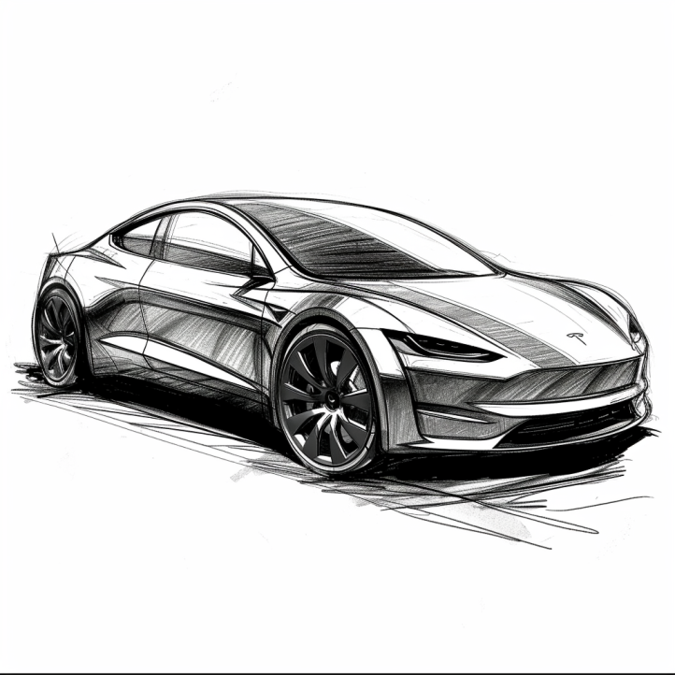
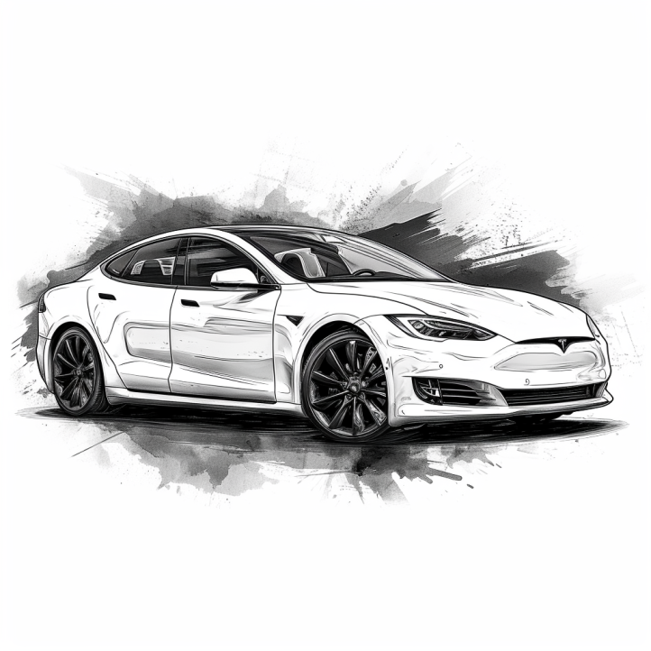
Cars are all software and sensors
Electric cars have numerous sensors and microcontrollers
Various sensors that are used in cars include:
Tracking location: GPS (global positioning system)
Distance measurement: Ultrasonic sensors
Terrain mapping: Lidar (light detection and ranging)
Proximity sensing: radar
Various forms of cameras
Motion sensor: accelerometers
…. And many more
Notes:
First, we look at the computational elements, and these consist of a microcontroller or an FPGA. Today, we find that these computational elements consume at least one order of magnitude higher power consumption when compared to the commonly used sensors.
However, we also find that microcontrollers are increasingly becoming energy efficient. We investigate a typical microcontroller that has been used in sensor platforms over the past two decades. We find that energy efficiency has improved by almost two orders of magnitude. Some of the present-generation microcontrollers, such as Ambiq Apollo4 consume just 3 uA/MHz than 330 uA for MSP430 used on platforms such as TelOS B.
If the trend continues, we can expect the microcontrollers to catch up with the sensors and become energy-efficient. This significant improvement is that the digital components are increasing becoming efficient as they follow moore’s law.

Slide 10
So, what are sensors ?
They are an eyes and ears for an embedded device. They sense environment and help to understand the physical world. Sensor is an electronic component that measures a physical phenomenon.
What are the phenomenon that you would like to sense and measure?
Temperature
Humidity
Acoustic
Vital signs
…….
Choice of sensor depends on the target embedded application
Notes:
First, we look at the computational elements, and these consist of a microcontroller or an FPGA. Today, we find that these computational elements consume at least one order of magnitude higher power consumption when compared to the commonly used sensors.
However, we also find that microcontrollers are increasingly becoming energy efficient. We investigate a typical microcontroller that has been used in sensor platforms over the past two decades. We find that energy efficiency has improved by almost two orders of magnitude. Some of the present-generation microcontrollers, such as Ambiq Apollo4 consume just 3 uA/MHz than 330 uA for MSP430 used on platforms such as TelOS B.
If the trend continues, we can expect the microcontrollers to catch up with the sensors and become energy-efficient. This significant improvement is that the digital components are increasing becoming efficient as they follow moore’s law.

Slide 11
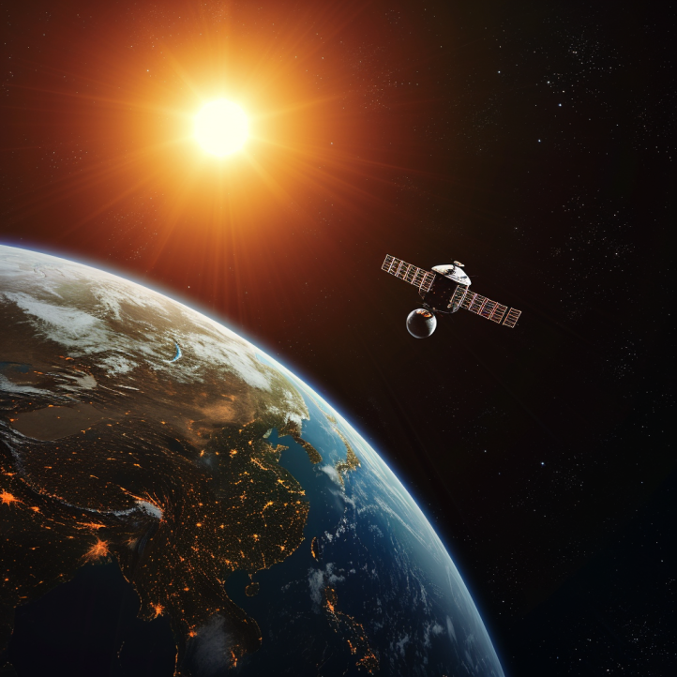
Different forms of sensing: Active vs Passive
Passive Sensing
Active Sensing
When we talk about embedded systems we focus on passive sensing. As It is much cheaper and at a lower energy consumption

Slide 12
Digital microcontrollers, analog world, and sensors
Microcontrollers: Digital component designed to process digital signals. They interpret commands from the software programmed into their memory.
Analog vs. Digital: The physical world is inherently analog, meaning it varies continuously. A common example of an analog phenomenon is the fluctuation of temperature or humidity.
Sensors are devices that monitor physical phenomena and convert them into electrical signals. These electrical signals can then be processed by microcontrollers to support an embedded application

Slide 13
Sensors transform phenomenon into electrical signals
How sensors convert physical phenomena into electrical signals, we refer to Ohm's Law, which states that Voltage (V) equals Current (I) times Resistance (R)
V (Voltage) = I (Current) X R (Resistance)
By altering one of the variables in Ohm’s law —Voltage (V), Current (I), or Resistance (R)—in response to changes in the phenomenon, a sensor generates an analog electrical signal that corresponds to that phenomenon.

Slide 14
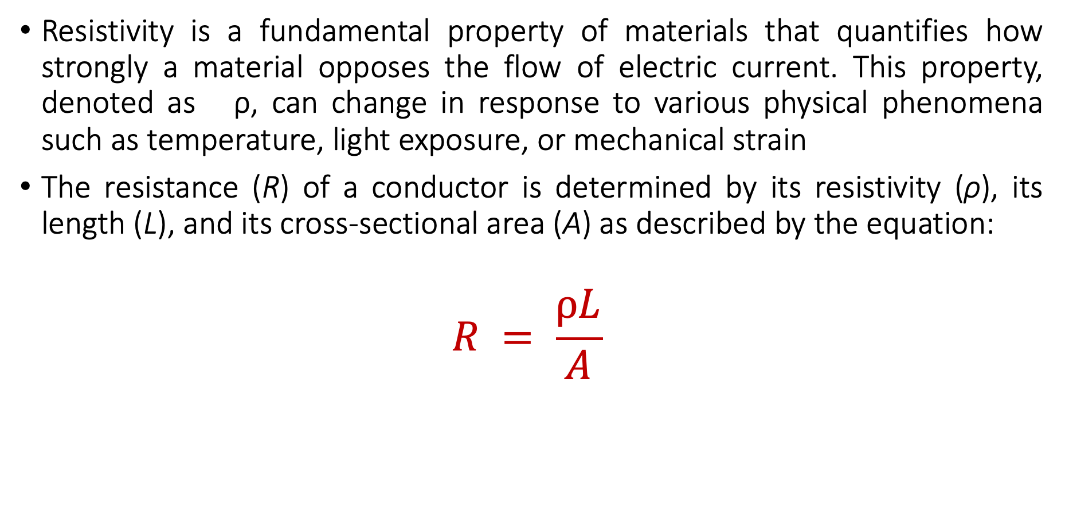
Material Resistivity and its Role in Sensing Phenomena
Resistivity is a fundamental property of materials that quantifies how strongly a material opposes the flow of electric current. This property, denoted as ρ, can change in response to various physical phenomena such as temperature, light exposure, or mechanical strain
The resistance (R) of a conductor is determined by its resistivity (ρ), its length (L), and its cross-sectional area (A) as described by the equation:
$$R = \frac{ρL}{A}$$

Slide 15
Material Resistivity and its Role in Sensing Phenomena
Resistivity (ρ): Materials with higher resistivity create more resistance for the same length and area. Resistivity is sensitive to physical conditions;
Temperature: Many conductors have higher resistivity at higher temperatures.
Light: Some materials (like photoresistors) change their resistivity exposed to light.
Strain: Materials known as strain gauges increase in resistivity when stretched.

Slide 16
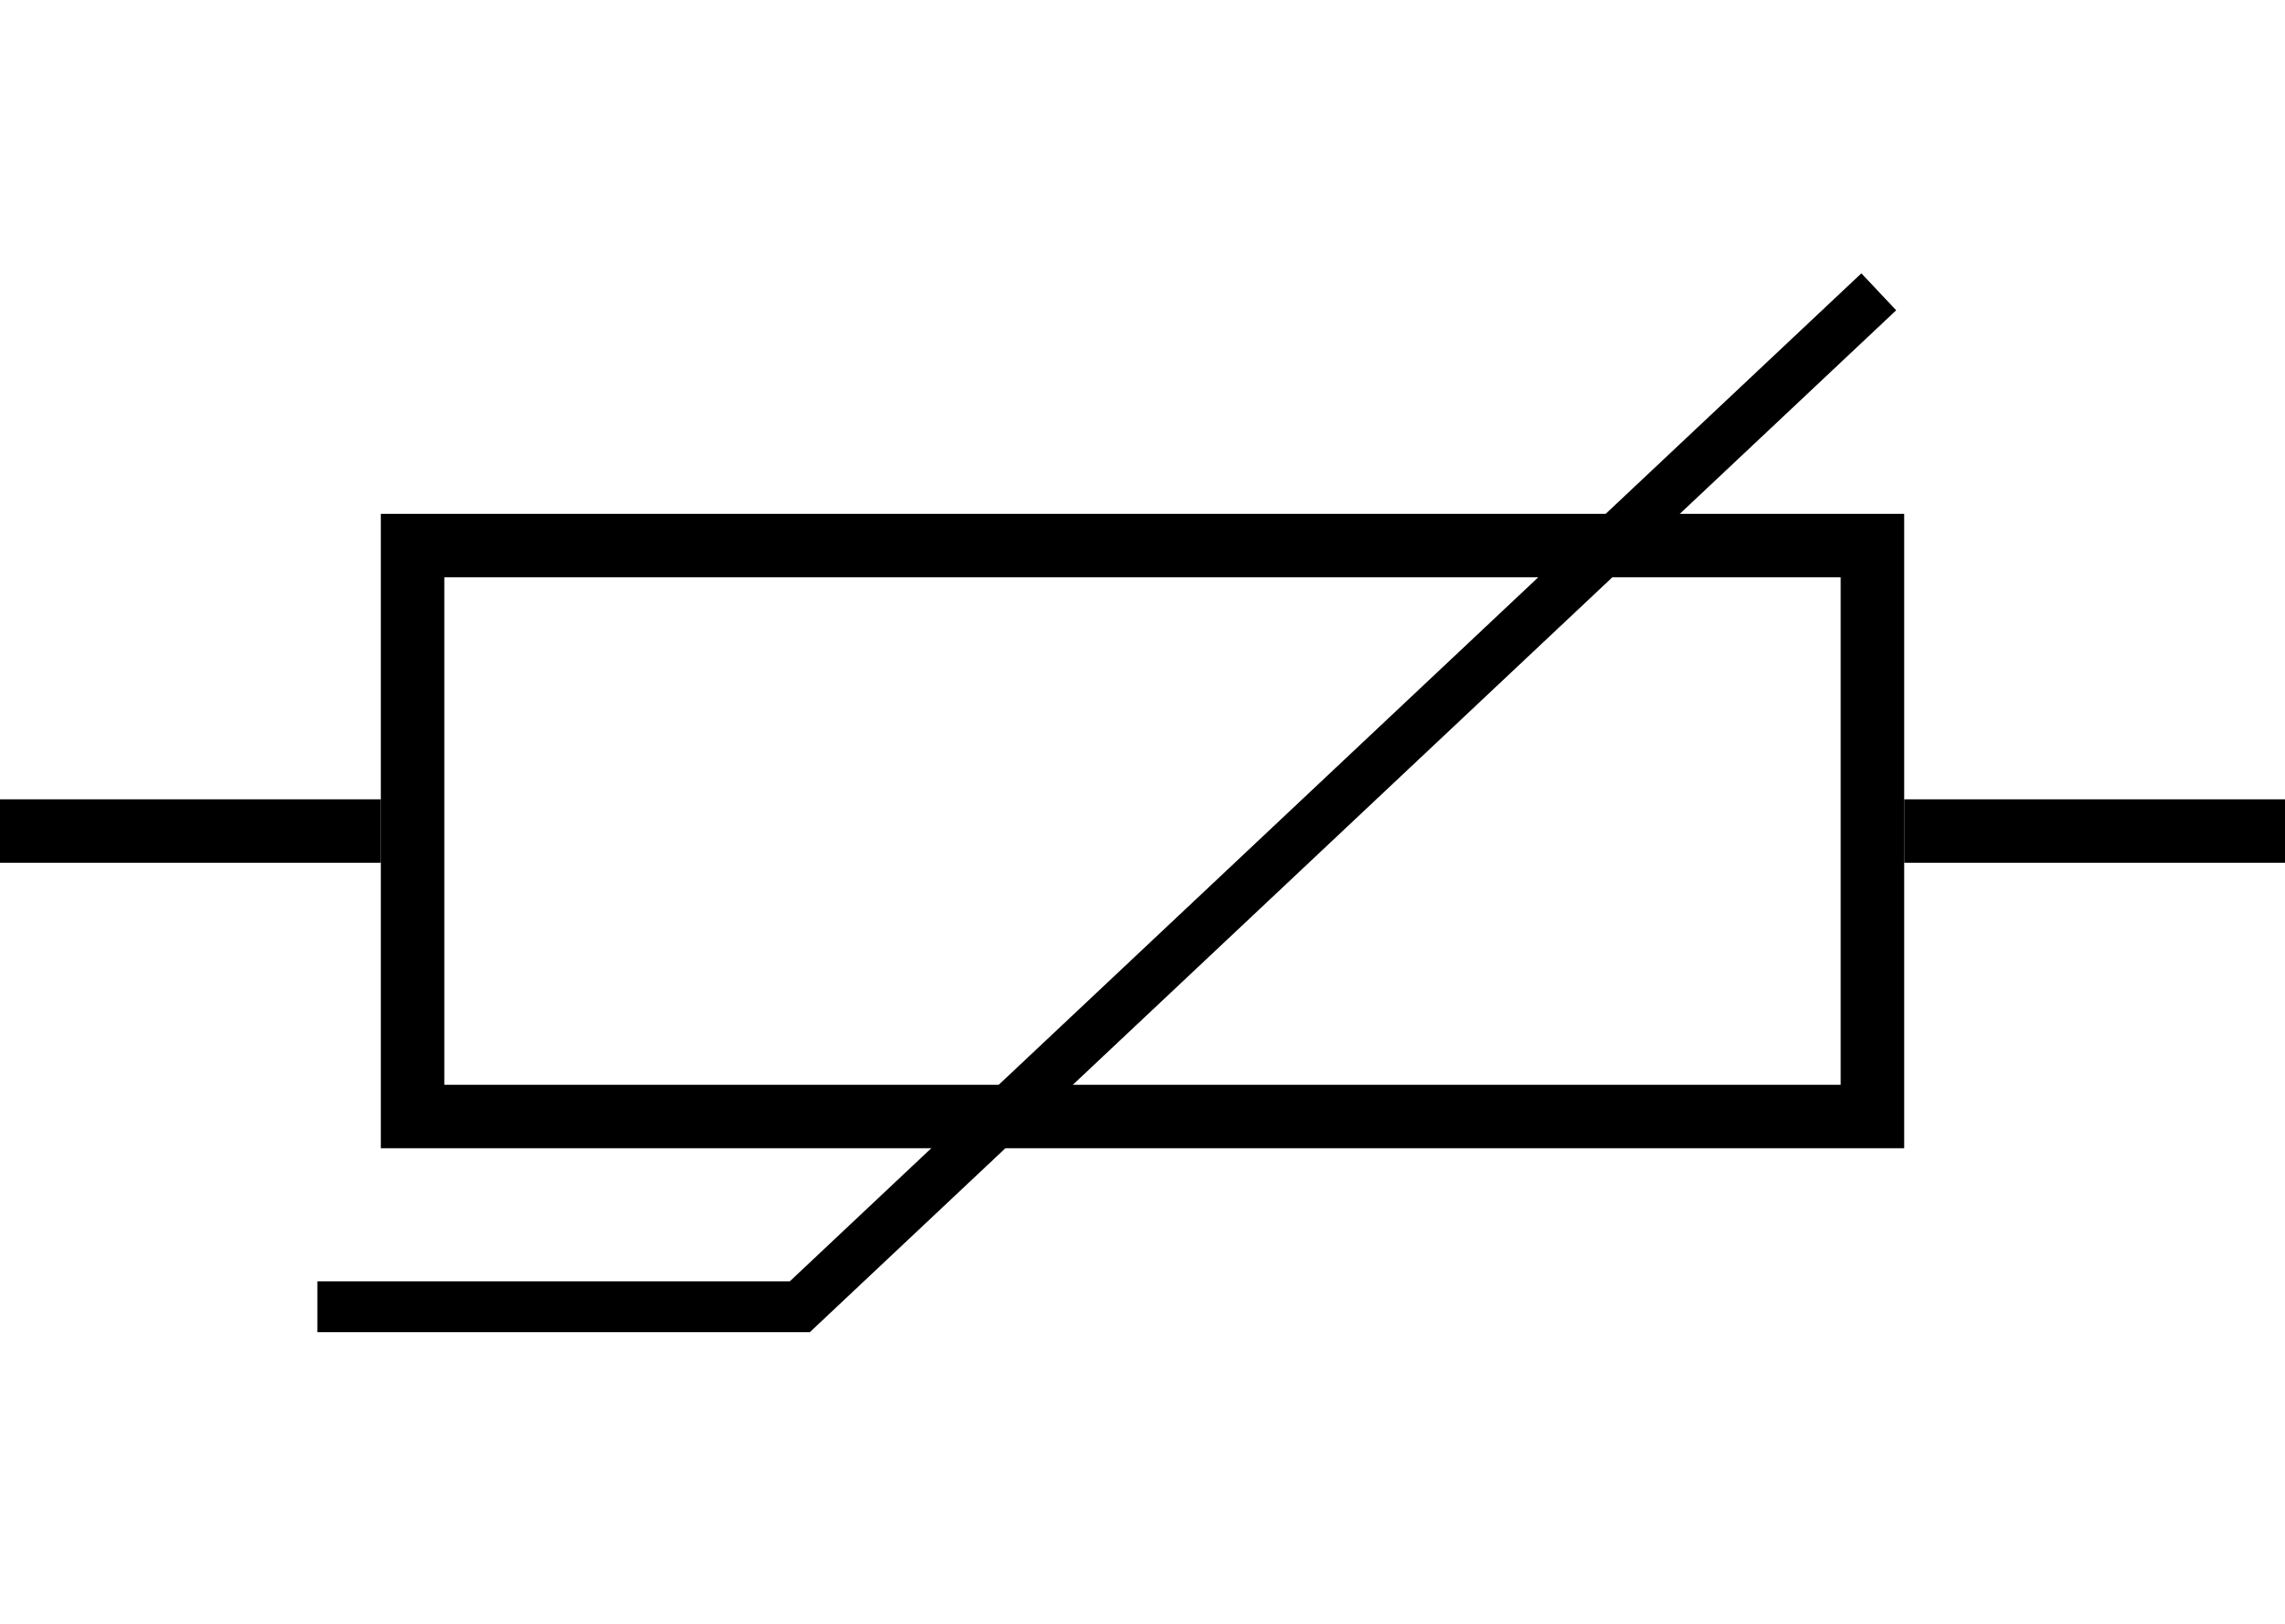
Temperature sensing using resistivity changes
Thermistor is a sensor which varies in resistance based on temperature
Advantages: They are cheap and easy to use. Low cost
Disadvantages: They have a non-linear transfer function

Slide 17
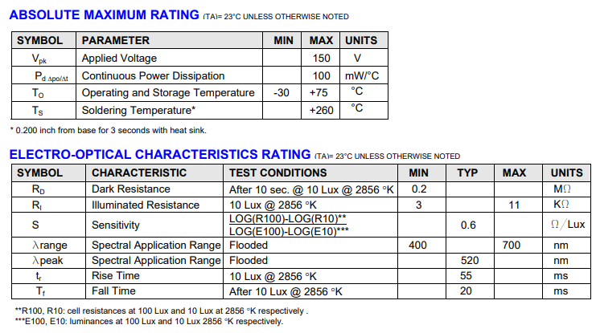
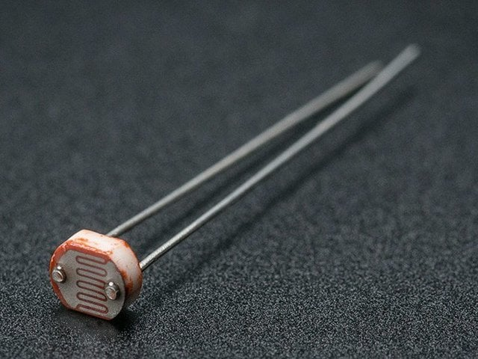
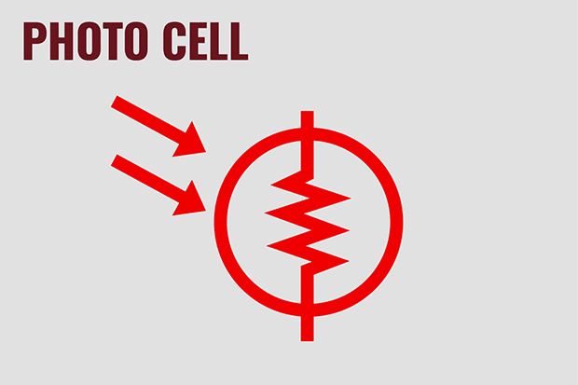
Light sensing using resistive changes
Photocell changes resistance with light (non-linear)
Example:
10 kΩ when dark
1 kΩ when light

Slide 18
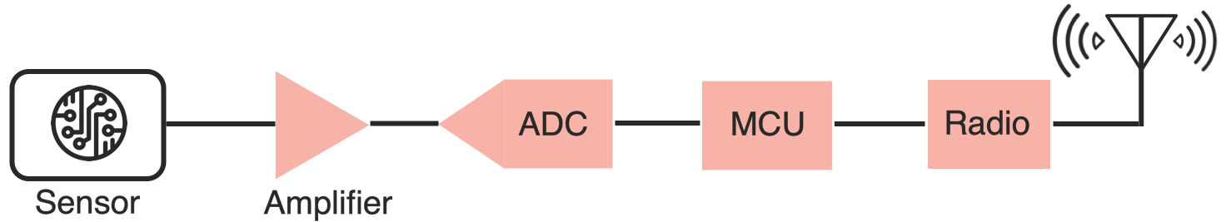
Taking a step back: Microcontrollers are digital
Up to this point, we have talked about translating physical phenomenon to analog electrical signal changes
How do we convert the analog signal into digital?
Do we need to do any processing before the conversion operation?
Conventional and widely used architecture of embedded wireless platform
Notes:
Why do the IoT platforms suffer from this energy challenge? To understand this, we investigate the architecture of the IoT device. We show this architecture in the figure on the slide. It consists of a series of stages that enable us to sense physical phenomena, process and transmit the sensor information through a transceiver such as ZigBee/BLE/LoRa.
This architecture has remained unchanged over the past two decades. We find that during this time, sensors have become exceeding efficient. Today, we find sensors such as an accelerometer or a temperature sensor consumes just a few tens of microwatts of power consumption. However, we find that rest of the architecture components that are shown in red colour remain significantly energy expensive. To understand the reason for this significant energy asymmetry, we look at the following slide.

Slide 19
ADC: Bridging the analog and digital worlds
ADCs convert analog signals, which have a continuous range of values, into digital signals, which have discrete numerical representations. This is essential for digital devices to process real-world analog inputs
What are the various parameters of the ADC?
Resolution: Determined by the number of bits the ADC uses to represent the analog value. More bits mean higher resolution and finer granularity in the output
Sampling Rate: The frequency at which the ADC samples the analog signal. Higher sampling rates can capture more detail and are necessary to comply with the Nyquist theorem. It also means higher power consumption
Accuracy: The closeness of the ADC's output to the true input value. It includes factors such as linearity, noise, and error rate
Notes:
Why do the IoT platforms suffer from this energy challenge? To understand this, we investigate the architecture of the IoT device. We show this architecture in the figure on the slide. It consists of a series of stages that enable us to sense physical phenomena, process and transmit the sensor information through a transceiver such as ZigBee/BLE/LoRa.
This architecture has remained unchanged over the past two decades. We find that during this time, sensors have become exceeding efficient. Today, we find sensors such as an accelerometer or a temperature sensor consumes just a few tens of microwatts of power consumption. However, we find that rest of the architecture components that are shown in red colour remain significantly energy expensive. To understand the reason for this significant energy asymmetry, we look at the following slide.

Slide 20
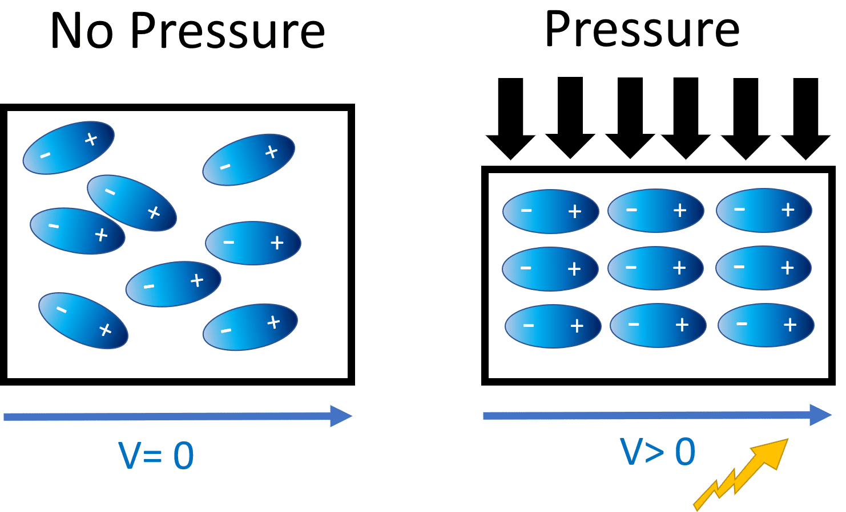
Generating voltage via piezoelectric effect
Compression of the material generates a voltage
Various sources of compression:
Air Pressure
Acceleration
Strain

Slide 21
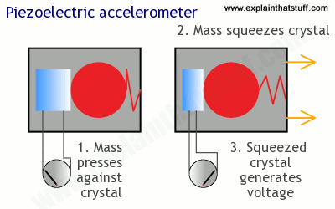
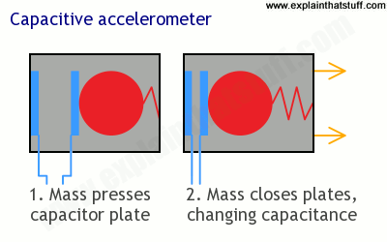
Beyond resistive changes sensing: Potential
Generate a change in voltage that changes based on force

Slide 22
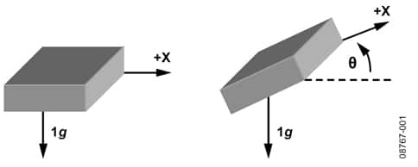
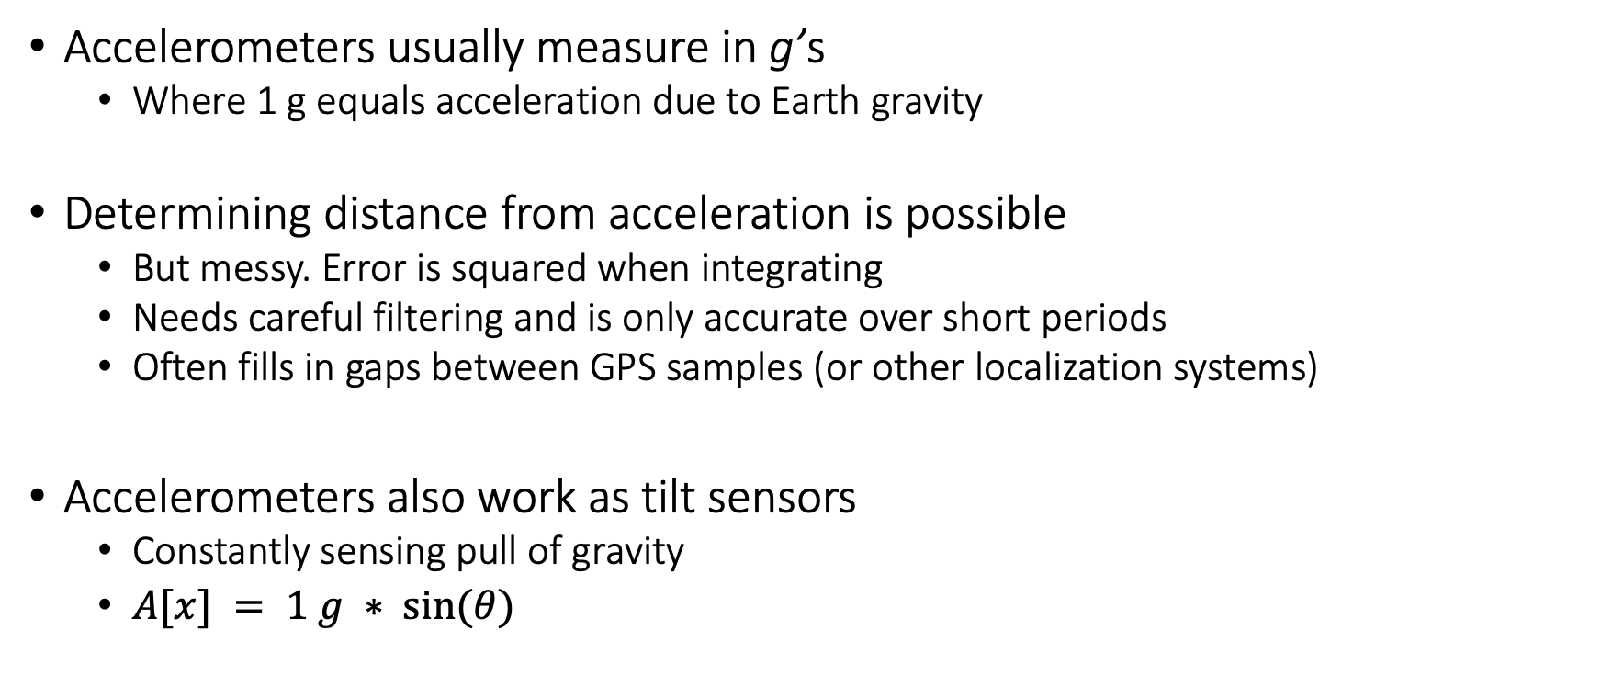
Motion sensing: accelerometers
Accelerometers usually measure in g’s
Where 1 g equals acceleration due to Earth gravity
Determining distance from acceleration is possible
But messy. Error is squared when integrating
Needs careful filtering and is only accurate over short periods
Often fills in gaps between GPS samples (or other localization systems)
Accelerometers also work as tilt sensors
Constantly sensing pull of gravity
$A[x] = 1 g ∗ sin⁡(θ)$

Slide 23
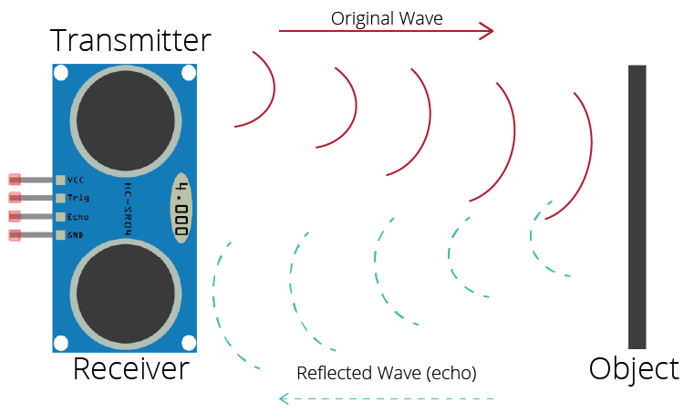
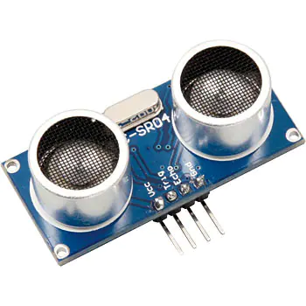
Active sensing: Ultrasound sensor
Emits high frequency sound waves from sensor which bounces from objects that are present in the environment
Estimates distance, proximity by measuring time taken for sounds waves to bounce back and propagate back to the ultrasound device
Power consuming, though can be used on IoT devices
Common application: Robotics, obstacle detection, water level sensing

Slide 24
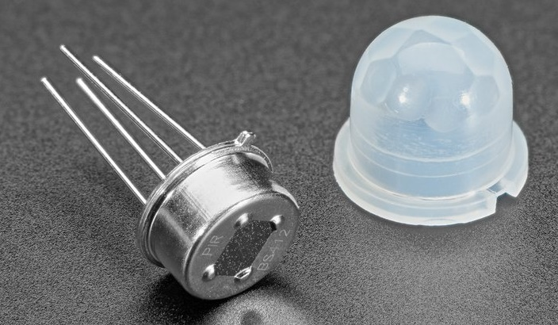
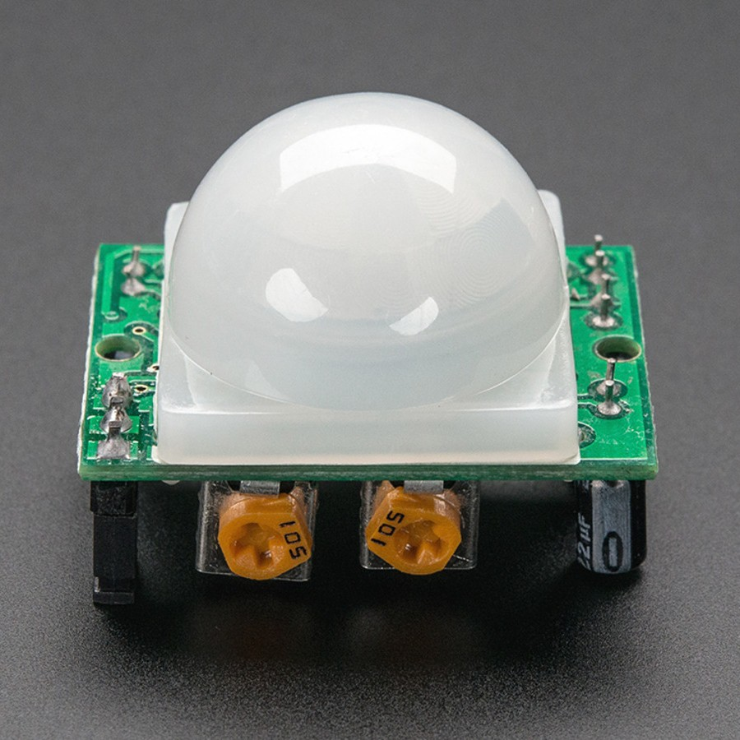
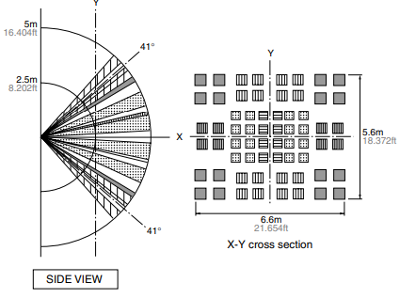
Passive Infrared (PIR) sensor
Detect movement in the environment
By detecting change in IR levels
Often come with plastic lens cover to improve field of view and range

Slide 25
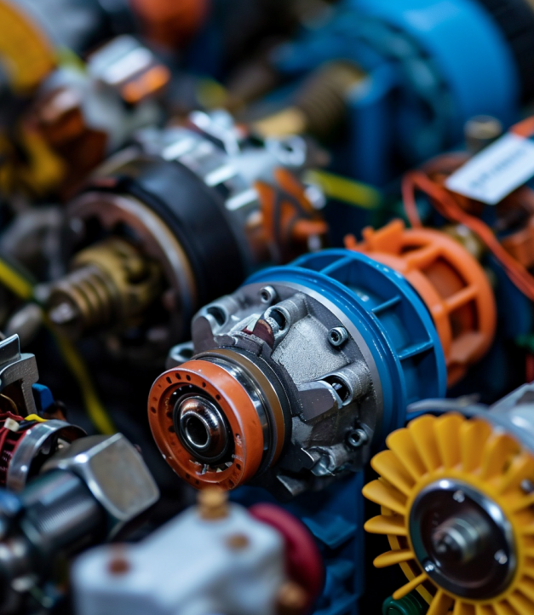
What are actuators?
Actuator is an electronic component that modifies a physical quantity
Light/LED
Motor
Speaker
…….
Notes:
First, we look at the computational elements, and these consist of a microcontroller or an FPGA. Today, we find that these computational elements consume at least one order of magnitude higher power consumption when compared to the commonly used sensors.
However, we also find that microcontrollers are increasingly becoming energy efficient. We investigate a typical microcontroller that has been used in sensor platforms over the past two decades. We find that energy efficiency has improved by almost two orders of magnitude. Some of the present-generation microcontrollers, such as Ambiq Apollo4 consume just 3 uA/MHz than 330 uA for MSP430 used on platforms such as TelOS B.
If the trend continues, we can expect the microcontrollers to catch up with the sensors and become energy-efficient. This significant improvement is that the digital components are increasing becoming efficient as they follow moore’s law.

Slide 26
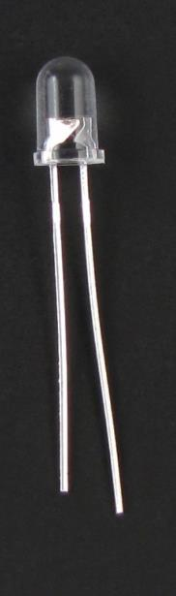
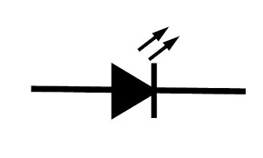
Light emitting diodes (LEDs)
Directional component: only allows current to flow one way
Shorter side is the negative one
i.e. where current flows to
Larger metal component
inside of case or case flat spot is cathode or
negative (-) lead
Shorter wire is cathode or
negative (-) lead
Negative ( - ) lead
Schematic Symbol
Notes:
Light Emitting Diodes (LEDs) are vital actuators for embedded and Internet of Things (IoT) devices. They provide a visual indication of the device's state and can also be used for debugging purposes. LEDs are directional components that allow current to flow in one direction only.
Typically, the cathode, where the current flows, is the shorter side of the LED. LEDs are an effective way to indicate the status of a device and provide feedback during the development and testing phase.
They are also commonly used in consumer electronics and lighting applications.

Slide 27
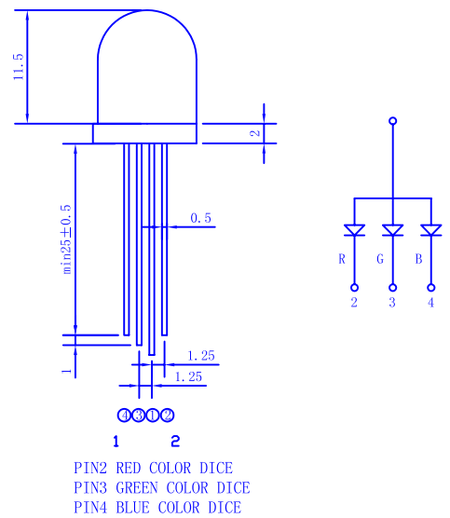
RGB LEDs
Three different colors of LED in a single large diffuser
Short leads are negative ends
One for each color
Long lead is common power
Common anode
Combinations of LEDs give other colors
Cyan, Yellow, Violet, White
https://cdn-shop.adafruit.com/datasheets/FLR-100WAS-RGB.pdf
Notes:
A unique variant of LEDs is the RGB (Red, Green, Blue) LED, which allows for the emission of three different colors. The short leads are the negative end, and each color has its own separate wire. By combining signals on multiple wires, a range of colors can be produced. RGB LEDs provide a versatile and efficient solution for adding color to embedded and IoT devices, as well as for lighting applications. By controlling the intensity of each color, a wide range of hues and shades can be generated, making RGB LEDs ideal for applications where dynamic color changes are desired.

Slide 28
Roadmap of the lecture today
Let us recall what was covered in the last lecture
Basics of Wireless communication
Microcontrollers and storage
Contiki operating system
Battery lifespan and radio states
Notes:
Here is the roadmap of the major topics that I am going to cover during the presentation. We have already covered the exponential growth of the internet of things; next, I will talk about the critical energy challenge that can severely hinder this massive growth and preventing us from realising this immense economic value enabled by the IoT.

Slide 29
Basics of wireless communication and networking
Link Budget: One of the metrics that help you understand the gains and losses in a communication system. Applicable to radio waves, communication happening through cables, and other systems
High link budget ensures that the wireless signal is received with a sufficient signal to noise (SNR) ratio for recovering of the sent information
Receiver Power (dBm) = Transmitted Power (dBm) + Gains (dB) – Losses (dB)

Slide 30
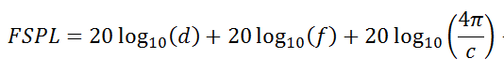
Basics of wireless communication and networking
Free space path loss (FSPL or FSL): The loss of power encountered by signal as it transmits from the transmitter to the receiver
d is the distance between the transmitter and receiver antennas (in meters),
f is the frequency of the signal (in Hertz),
c is the speed of light in a vacuum

Slide 31
Basics of wireless communication and networking
Signal to Noise (SNR) ratio: It is defined as the ratio of the desired or target signal when compared to the background noise
SNR = P(signal) / P(noise)
Often, SNR as a ratio is expressed in the units of decibel (dB)
SNR = 1, what would be the value in decibel?
We would like to have the SNR to be as high as possible. For communication systems, it means stronger desired signal, resulting in better link quality and reliability

Slide 32
Basics of wireless communication and networking
How do you estimate the capacity of the channel?
And what do you mean by the capacity of the channel?
Shannon capacity of the channel: The bandwidth available (B) , The quality of the channel (the level of noise, SNR)
C = B * log₂(1+SNR)
Intuitively, capacity increases with available bandwidth (linear) and increases with SNR (log)

Slide 33
Various tradeoffs in range, frequency, datarate, power
Power is (usually) a constraint
Increase in power can result in higher range/data rate
Lower lifespan of the device
Increase data rate (C)
Increase throughput by using a larger bandwidth (B)
Transmits at higher frequencies (f)
Range decreases and vice versa
Improve design to increase gain (G)
e.g. OFDM, MIMO etc.
C = B * log₂(1+SNR)
SNR – signal-to-noise ratio

Slide 34
Roadmap of the lecture today
Let us recall what was covered in the last lecture
Basics of Wireless communication
Microcontrollers and storage
Contiki operating system
Battery lifespan and radio states
Notes:
Here is the roadmap of the major topics that I am going to cover during the presentation. We have already covered the exponential growth of the internet of things; next, I will talk about the critical energy challenge that can severely hinder this massive growth and preventing us from realising this immense economic value enabled by the IoT.

Slide 35
Computation and Storage
Notes:
++ Over the past few years, I have designed several backscatter and beyond backscatter systems that precisely overcome these critical challenges that have limited the widespread deployment of backscatter on IoT devices.
++ The research vision that I have pursued and would like to pursue as a faculty member is to enable a massive deployment of IoT devices by bridging the energy asymmetry between sensing, computation and communication blocks by designing novel platforms and communication mechanisms. I am going to describe some of my research contributions next.

Slide 36
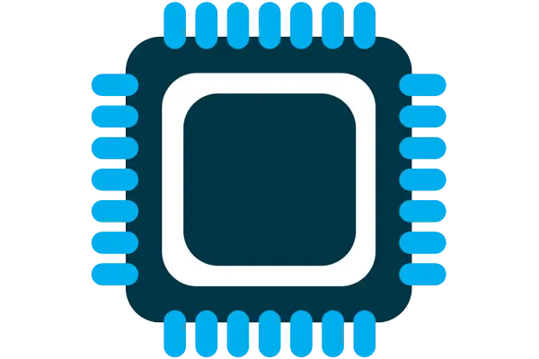



What are components of internet of things
Computation and Storage
Sensing and Actuation
Power
Wireless Connectivity
Notes:
First, we look at the computational elements, and these consist of a microcontroller or an FPGA. Today, we find that these computational elements consume at least one order of magnitude higher power consumption when compared to the commonly used sensors.
However, we also find that microcontrollers are increasingly becoming energy efficient. We investigate a typical microcontroller that has been used in sensor platforms over the past two decades. We find that energy efficiency has improved by almost two orders of magnitude. Some of the present-generation microcontrollers, such as Ambiq Apollo4 consume just 3 uA/MHz than 330 uA for MSP430 used on platforms such as TelOS B.
If the trend continues, we can expect the microcontrollers to catch up with the sensors and become energy-efficient. This significant improvement is that the digital components are increasing becoming efficient as they follow moore’s law.

Slide 37
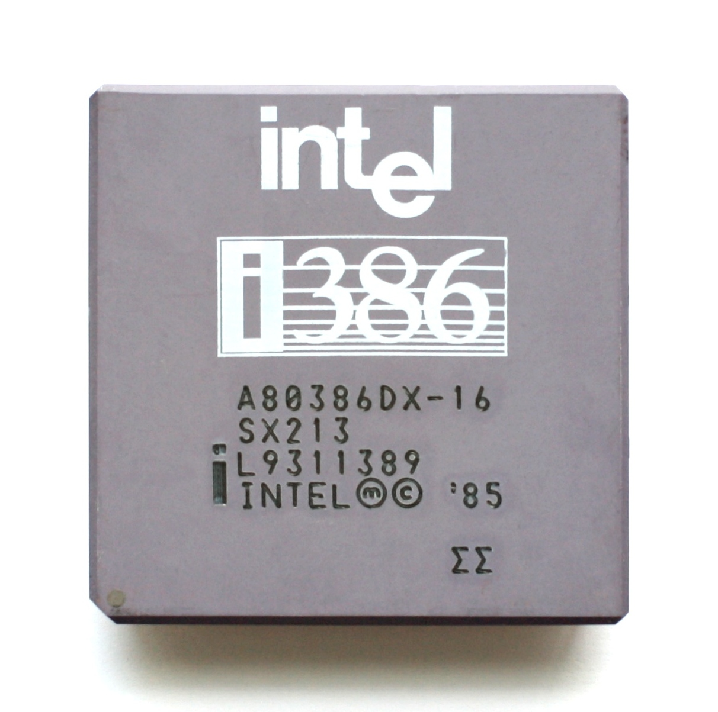
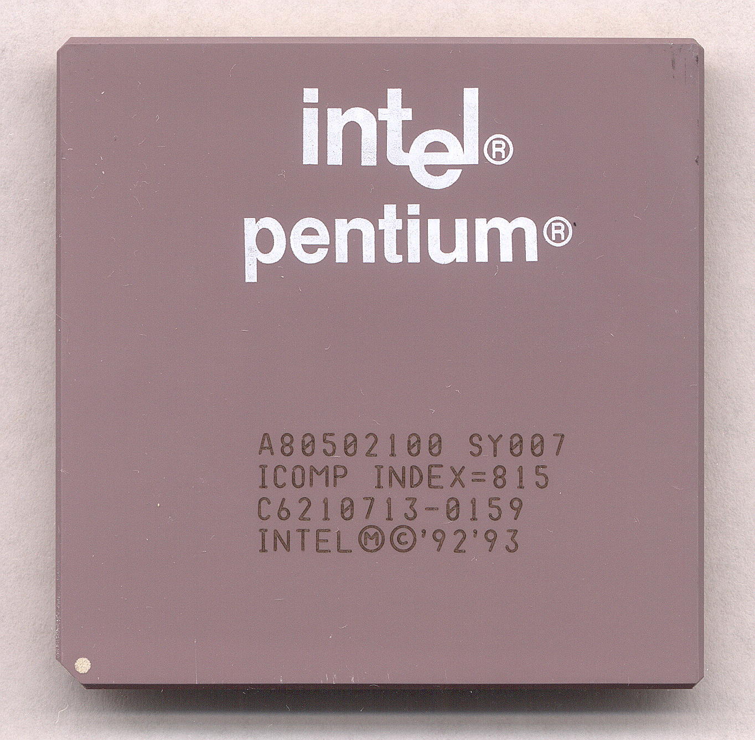
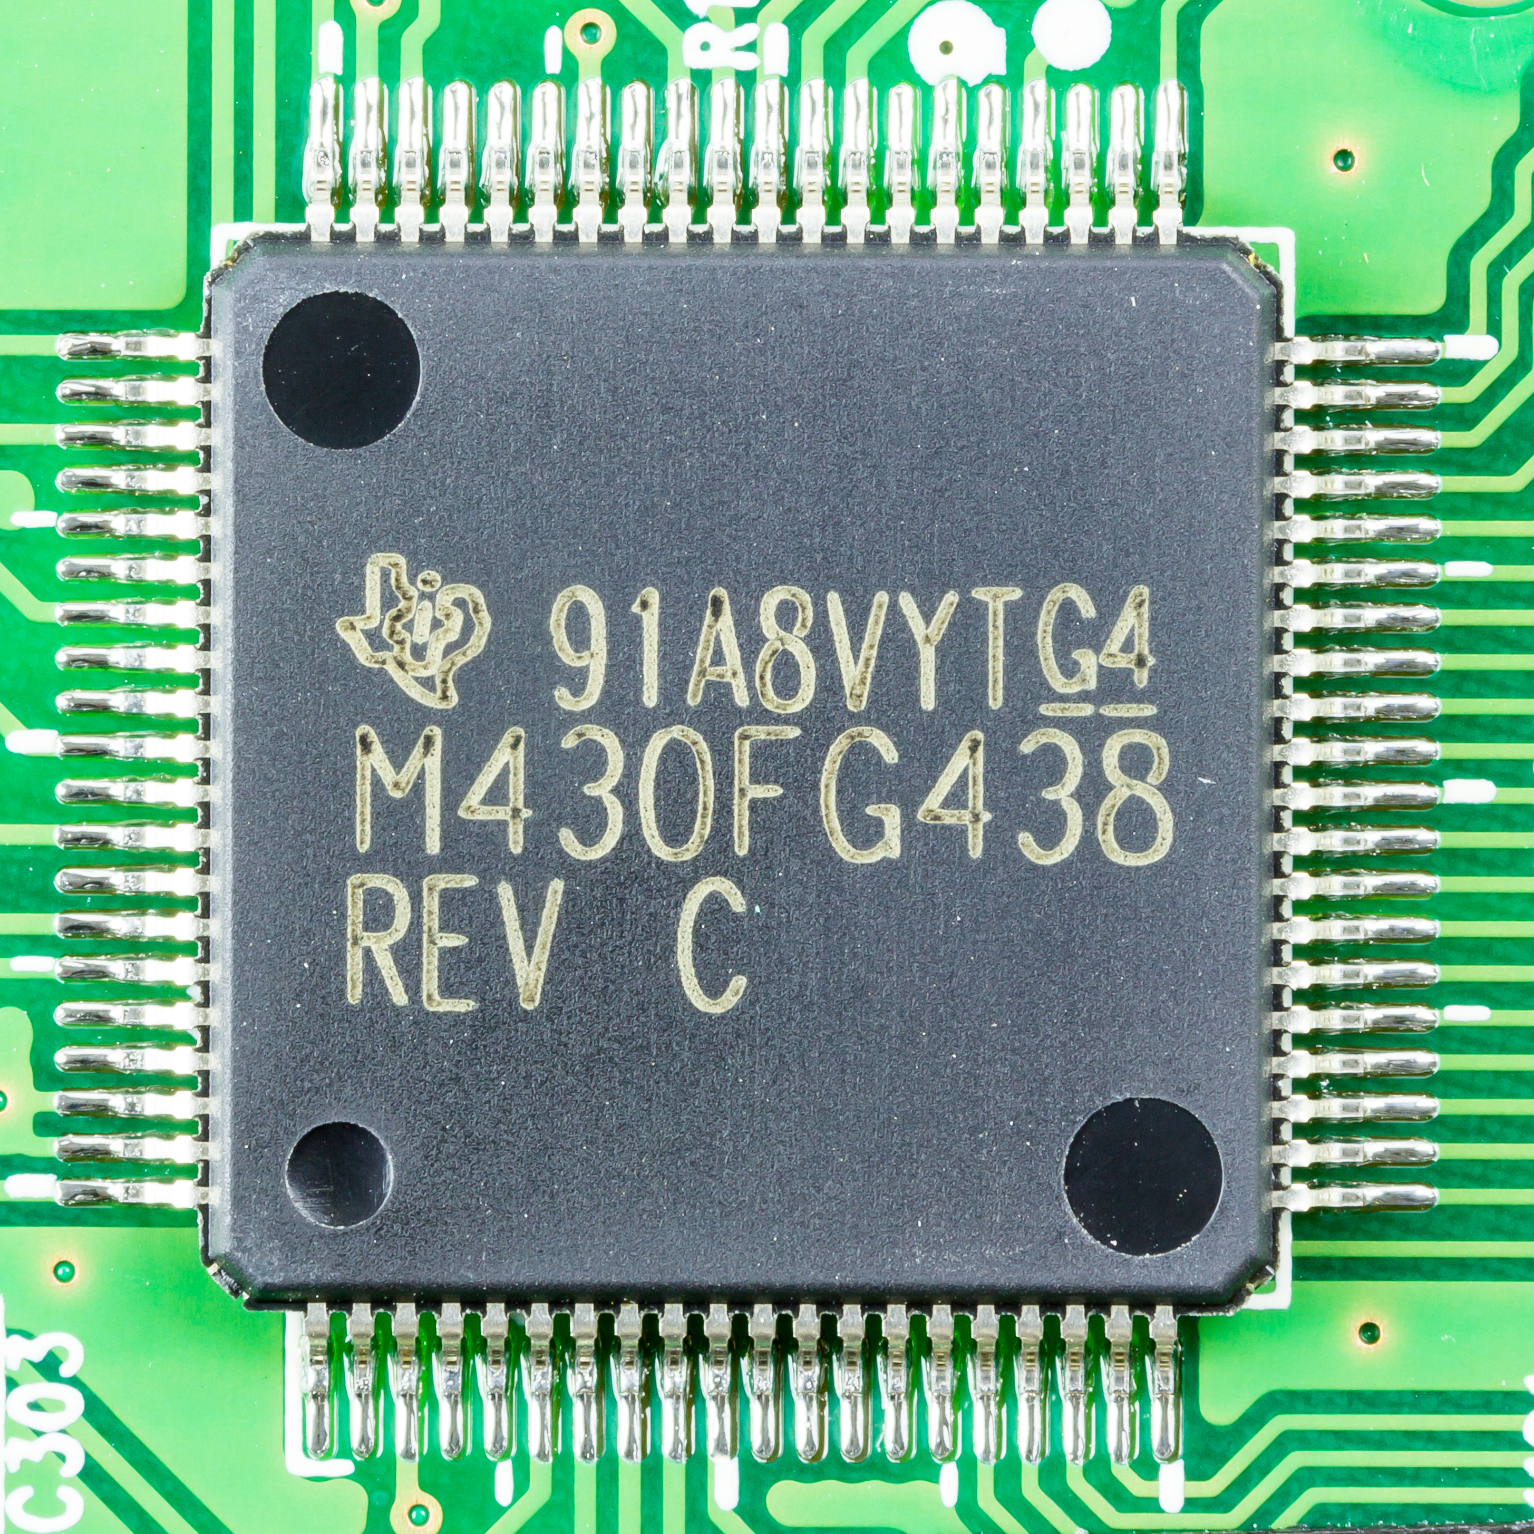
What is heart of computers and internet of things
Microprocessor (Computers)
They usually don’t have peripherals or memory
CPU + Pins (No memory, peripherals)
Your computer typically has a microprocessor
Microcontrollers (Internet of Things)
Memory + Peripherals + CPU + Pins
Peripherals: Specialized hardware units within the chip
Notes:
Backscatter communication actually help us overcome this limitation

Slide 38
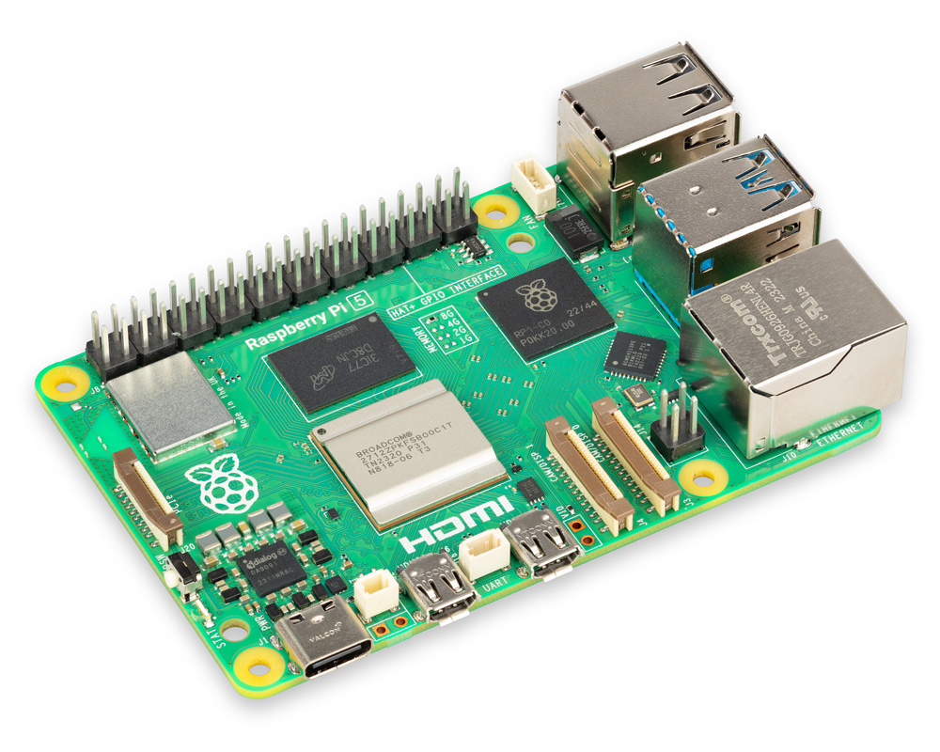
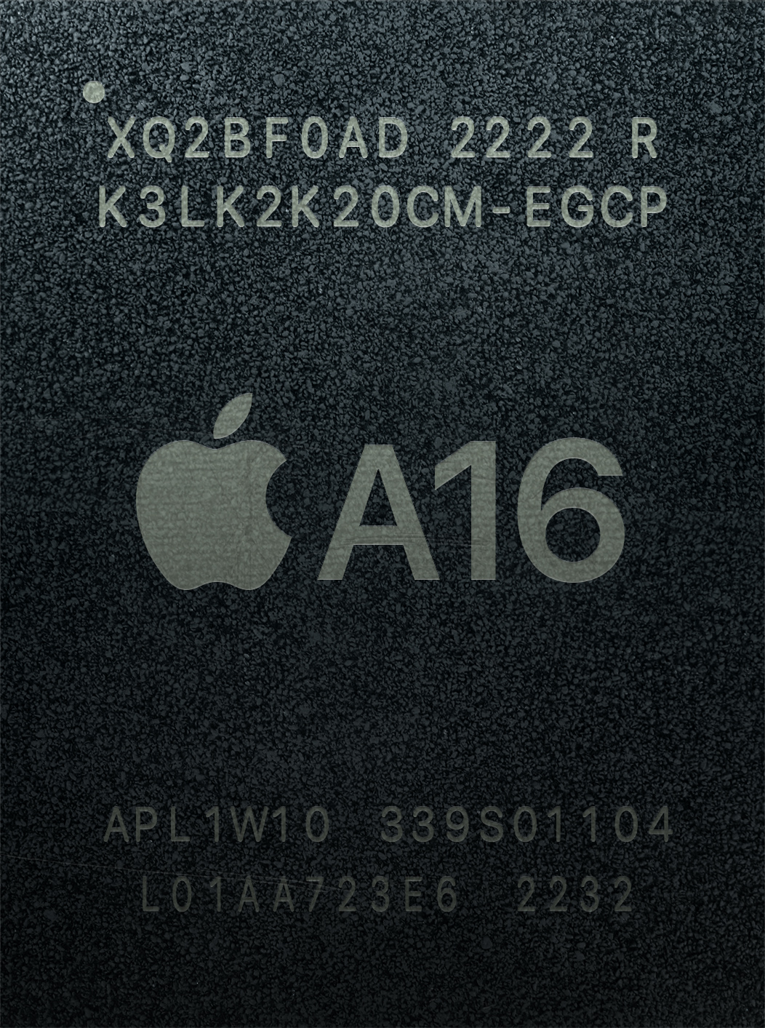
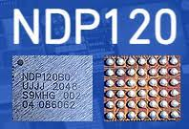
What is heart of computers and internet of things
System on chips (SoC)
Microcontroller + Extensive Peripherals
Essentially multiple chips combined
Example: Radios, ML accelerators in a single chip
Dedicated accelerator chips
Designed for a specific purpose like for speech detection
Notes:
Backscatter communication actually help us overcome this limitation

Slide 39
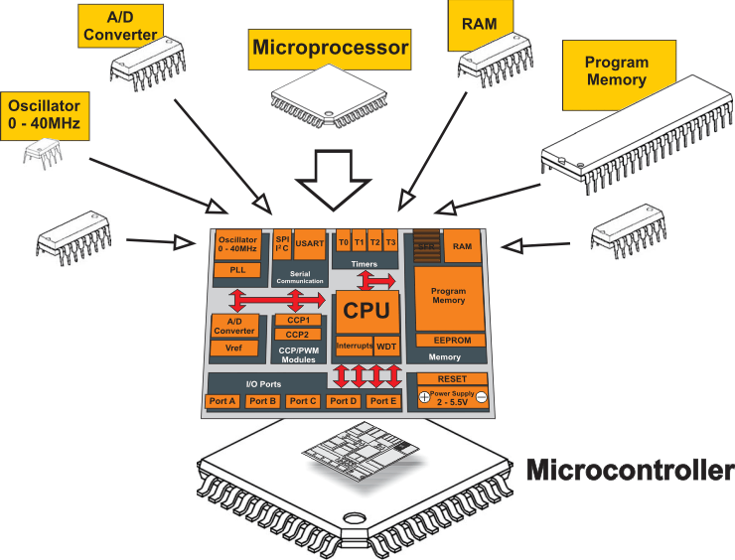
What is a microcontroller? Microprocessor + Peripherals + Memory + Pins + ?
Microcontroller
Processor
Peripherals
Pins
Memory
Notes:
Backscatter communication actually help us overcome this limitation

Slide 40
What are examples of microcontroller peripherals
Hardware modules that perform some action
Common examples
Control digital input and output pins
Read analog inputs
Send messages in a given wire protocol (UART, SPI, I2C)
Set and check timers
Less common examples
Cryptography accelerators
Complicated wire protocols (USB, CAN)
Wireless radios (BLE, 802.15.4, WiFi)

Slide 41
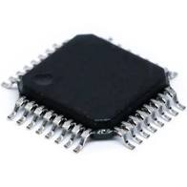
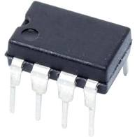
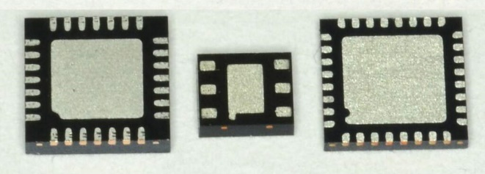
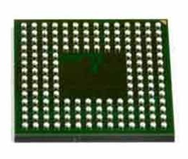
Connecting peripherals on microcontrollers
Peripherals need to electrically connect to outside world
Attach to pins on the exterior of the chip
More pins allow for more connections
At increased cost and size
Pin layouts can add more pins for cheaper
But make soldering and debugging difficult
Peripherals need to connect to external pins
Modern microcontrollers allow any-to-any connections

Slide 42
An image of the die of a microcontroller

Slide 43
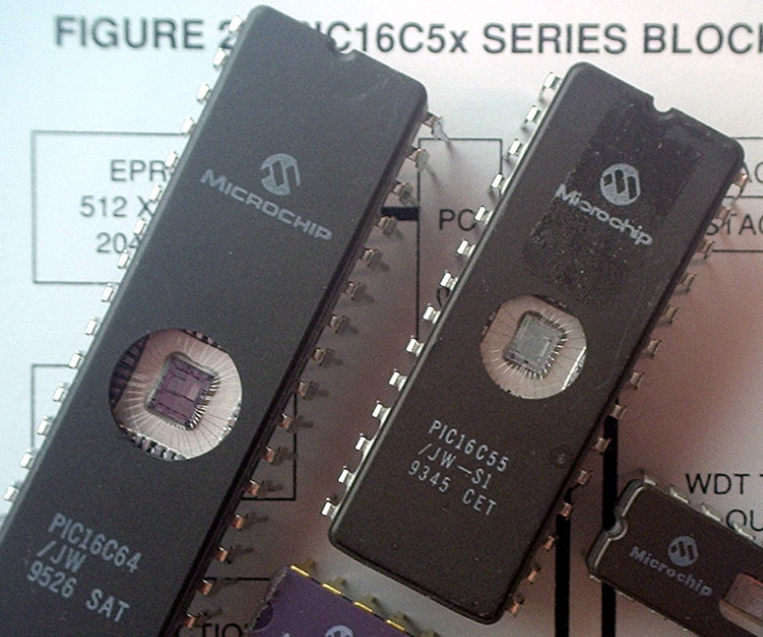
Some example of older microcontrollers
Cheap , small computer systems
PIC
8, 16, and 24-bit MIPs architecture
PICAXE available with Basic interpreter
AVR
8-bit custom architecture (AVR architecture)
Used in Arduinos
AT Tiny 4: $0.30 per unit
4 I/O pins, 32 Bytes RAM, 512 Bytes ROM

Slide 44
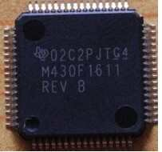
More capable microcontrollers (00s-10s)
Diversify into extreme low power and more capable systems
MSP430
16-bit custom architecture (MSP430 architecture)
Capable, but also extremely low power
<1 μA sleep current
STM32, Atmel SAM series (Cortex-M0, M3, M4, M4F)
32-bit ARM architecture (ARMv7)
Leverage success of ARM on smartphones
Every peripheral under the sun. Plus a variety of memory choices

Slide 45
Modern system-on-chips (10s-?)
Focus: increase memory and capability
Include radios in the same chip
Machine learning accelerators and other dedicated functionality
nRF51 and nRF52 series
32-bit ARM microcontrollers (Cortex M)
Include 2.4 GHz radio: Bluetooth Low Energy and 802.15.4/Thread
Others have followed this same path
TI CC26XX
Apollo3
STM32WL

Slide 46
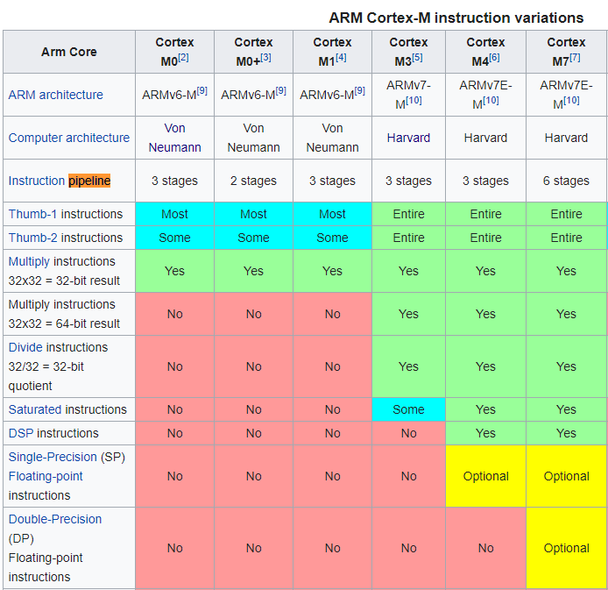
ARM Cortex M Series
A number of options for increasing capabilities
In practice:
Cortex-M0+ for low-end systems
Coretx-M4 for high capability systems

Slide 47
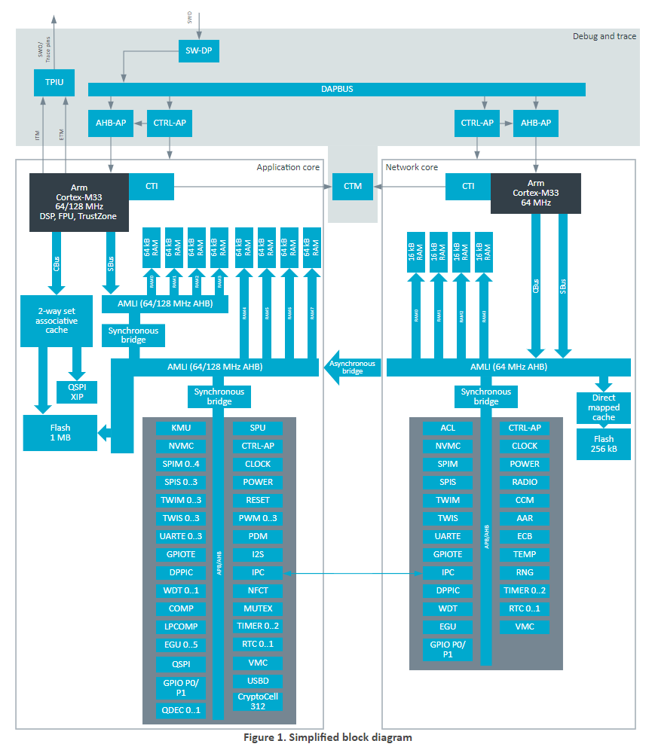
What are trends for future microcontrollers
Multi-core systems
Not for performance, but for separation of concerns
Run radio code on one core
Application code goes on the other core
Also allows BIG.little architecture
Higher performance core when interpreting data
Lower performance core for sampling sensors
nRF53 series is already doing this
But support is still nascent

Slide 48
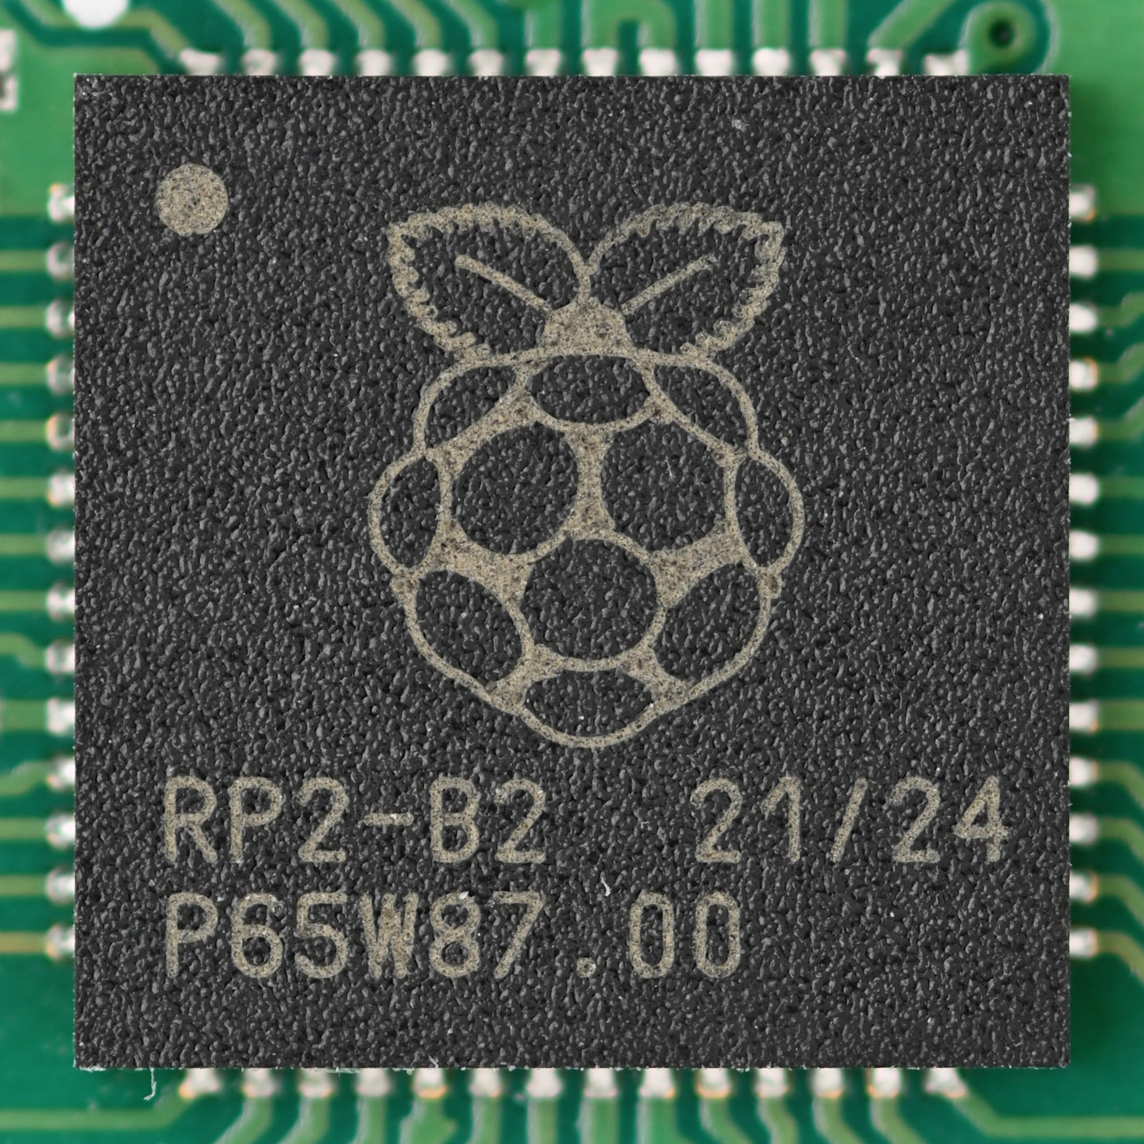
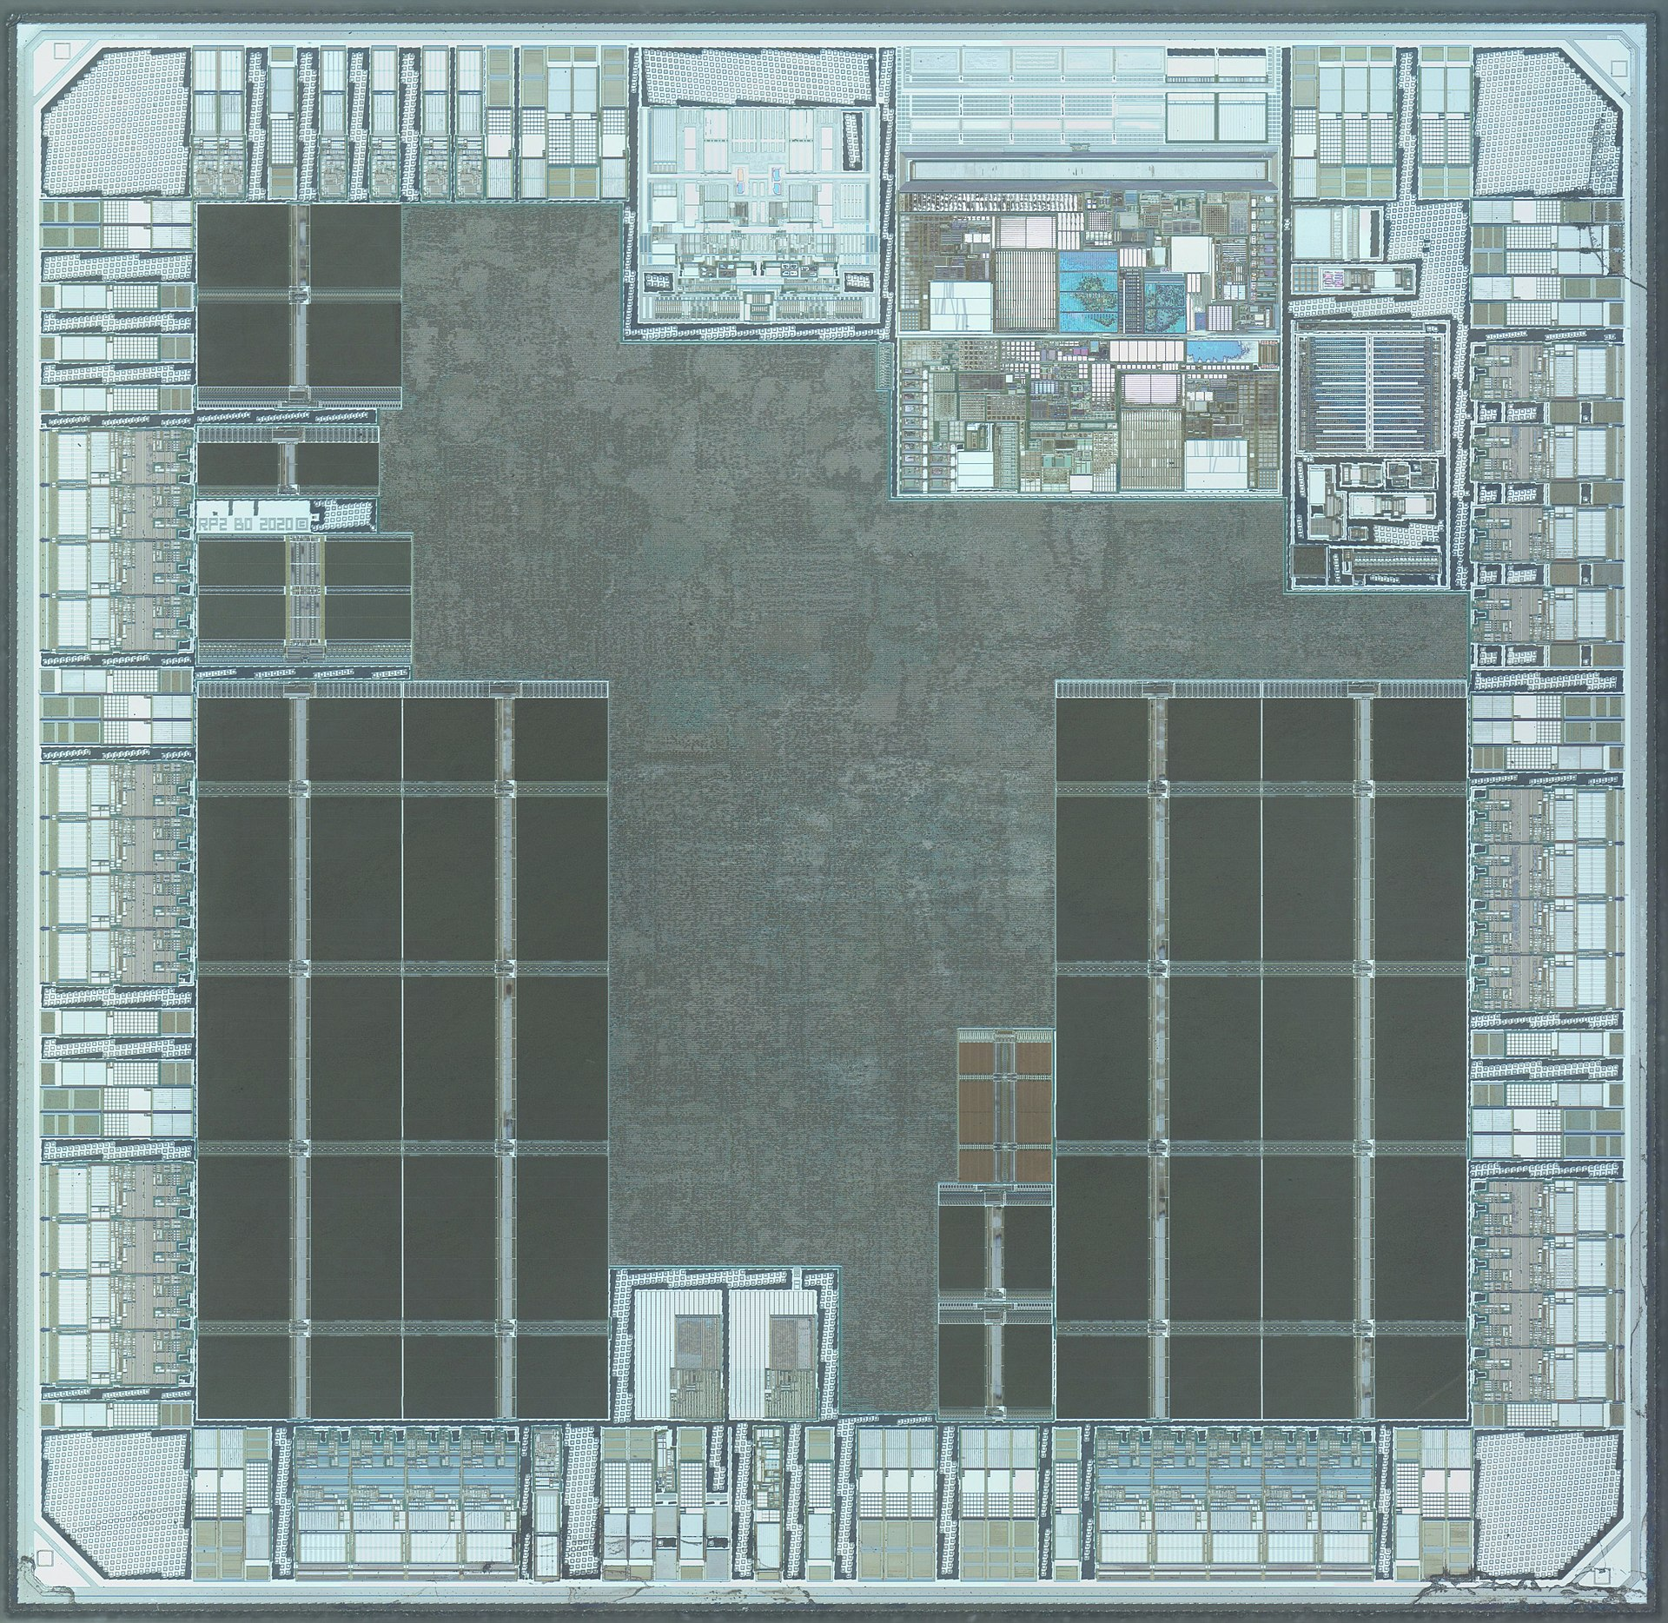
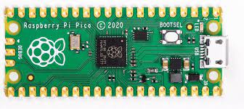
Raspberry Pi Pico: Multiple cores, Low-power

Slide 49
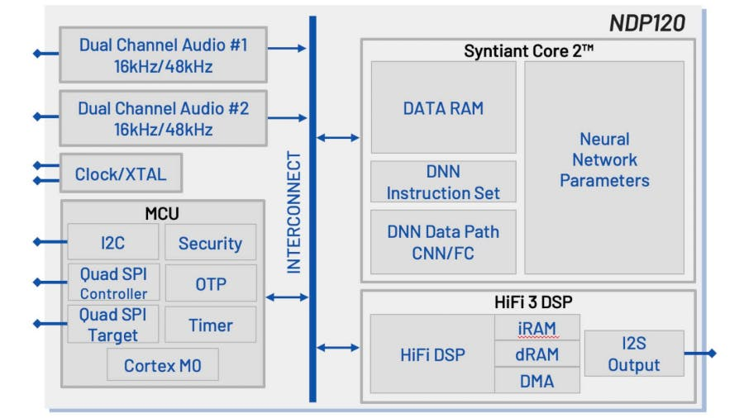
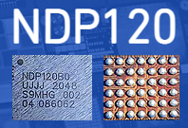
Microcontrollers with neural networks
Very low-power for specific tasks. Voice detection at hundreds of microwatts of power consumption

Slide 50
Microcontroller Memory
Notes:
++ Over the past few years, I have designed several backscatter and beyond backscatter systems that precisely overcome these critical challenges that have limited the widespread deployment of backscatter on IoT devices.
++ The research vision that I have pursued and would like to pursue as a faculty member is to enable a massive deployment of IoT devices by bridging the energy asymmetry between sensing, computation and communication blocks by designing novel platforms and communication mechanisms. I am going to describe some of my research contributions next.

Slide 51
Memory on microcontroller (hierarchy)
Registers
RAM
ROM

Slide 52
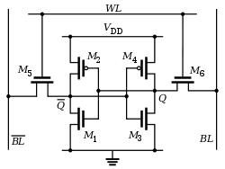
Example of volatile memory: SRAM
Same design as registers in traditional computer systems
No need to refresh it -> lower energy costs
Tradeoff:
More expensive
Physically larger

Slide 53
Example of non-volatile memory: Flash
Same design as SSDs and Flash drives
Memory is stored with no energy costs
Reading is lowish energy and quick
Writing is high energy and very slow
Writing also has to occur in blocks (e.g. 512 bytes)
Concern: Flash has a limited lifetime ~10,000 writes
Only writing to Flash when you load code? Essentially forever
Recording data to Flash every second? 2.8 hours

Slide 54
SRAM (RAM) versus Flash (ROM)
Size and time difference between non-volatile and volatile memory is significantly reduced from traditional computing
Non-volatile store 2-10x larger than volatile
Single-cycle RAM. Maybe two-cycles to Flash (to read)
Major difference: energy and writability
SRAM is low-energy to read and write (no refresh needed)
Flash is lowish-energy to read, but very high energy to write
Hierarchical structure is not enforced
Same address space for RAM and Flash (very different from traditional)
Run instructions right inside of Flash
Keep variables in RAM (or const variables in Flash)

Slide 55
How do you select microcontrollers?
Some of the metrics to be considered in making a selection:
Power consumption
Clock frequency
IO pins
Memory
Internal functions
Others? What else?

Slide 56
Processor design choices for embedded application
How many bits is the architecture?
8-bit and 16-bit not uncommon
64-bit is very rare (who has that much memory?)
What instructions are supported?
Normal stuff yes
What about single-cycle multiply?
What about floating-point operations?
Vector instructions?
How fast does it run?
1-100 MHz is common on modern systems (faster is more energy cost)
Occasionally MUCH slower (think 32 KHz)

Slide 57
Hardware Platform: CC2650 SensorTag
Processor: ARM Cortex M3 32-bit processor, up to 48-MHz clock speed
Memory: 8KB of SRAM for Cache, 20KB of SRAM, 128KB of In-System Programmable Flash
Network: 6LoWPAN, Bluetooth Low energy, RF4CE, ZigBee
10 sensors including support for light, digital microphone, magnetic sensor, humidity, pressure, accelerometer, gyroscope, magnetometer, object temperature, and ambient temperature

Slide 59
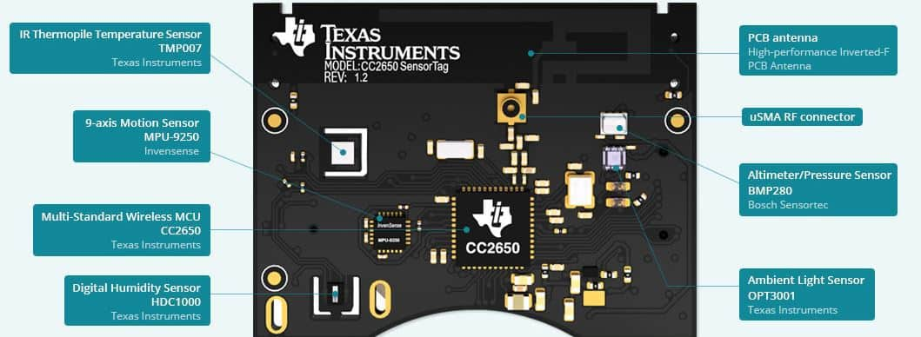

Slide 60
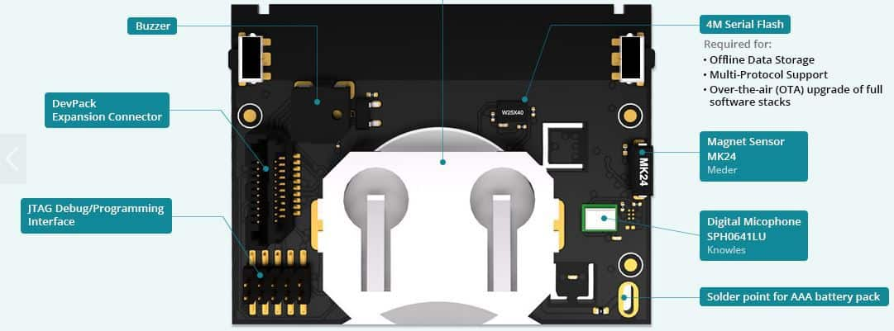

Slide 61
Roadmap of the lecture today
Let us recall what was covered in the last lecture
Basics of Wireless communication
Microcontrollers and storage
Contiki operating system
Battery lifespan and radio states
Notes:
Here is the roadmap of the major topics that I am going to cover during the presentation. We have already covered the exponential growth of the internet of things; next, I will talk about the critical energy challenge that can severely hinder this massive growth and preventing us from realising this immense economic value enabled by the IoT.

Slide 62
Operating system for the embedded platforms
Cannot run Windows or Linux. These operating systems are too resource intensive for constrained platforms like IoT devices
Embedded platforms: several operating systems for embedded platforms
Tiny OS (now almost dead)
Contiki OS
Zerphyr OS
We will use Contiki OS for assignment and projects in this course

Slide 63
An overview of the Contiki operating system
Memory-efficient: 2 kB RAM, 40 kB ROM typically, provides IP support (its uIPv6 stack is IPv6 Ready), supports multi-threading, Protothreads
Supports a wide array of embedded platforms (AVR, MSP430, MSB430, ESB, Apple II, C64, Atari Jaguar, Tandy CoCo, Casio PocketViewer, Sharp Wizard, PC 6001, and many others)
Open source. Written in C, released under BSD License.
Large community support from developers across the world

Slide 64



History of the Contiki operating system
Started in Sweden! Started by – Adam Dunkels at SICS
Awarded 2022 Sensys Test-of-Time Award for Protothreads (2004)
Companies and universities developing (or has contributed) Contiki OS:
SAP, Cisco, Atmel, NewAE and others
SICS, TU Munich and others

Slide 65
How small can really ContikiOS (with apps) get?
P – size of event queue, S – size of thread stack

Slide 66
Architecture of the Contiki operating system
Modular architecture
Event driven at kernel level, provides optional threading facilities
All OS facilities: senor data handling, communication, device drivers, etc. are provided in the form of services
Each service has its interface and implementation. Applications using a particular service need to know the service interface

Slide 67
Programming Models and Concurrency Support
Sequential (no parallelism)
Poll sensor
Process sensor data
Poll Radio
Process radio packet
Event-driven
Memory
Radio
Sensor
CPU
Multi-threaded
Handle sensor process
Handle radio process

Slide 68
Programming models and concurrency support
Event-driven model: Code only runs within event handlers
On an event occurrence: kernel invokes handler code
Event handler runs till completion: explicit return;
Event Handler 1
Event Handler 2
Kernel
Event Handler 3

Slide 69
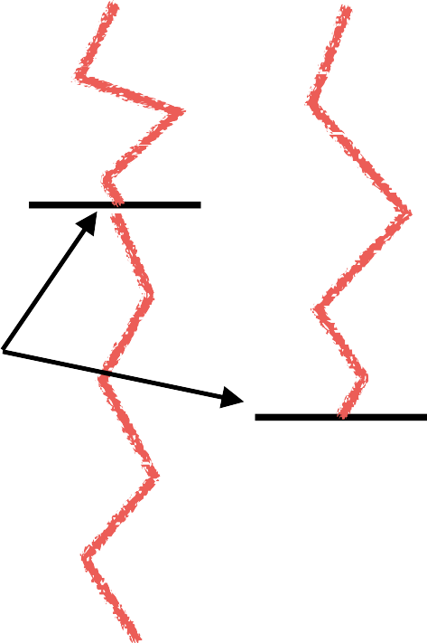

Multithreaded programming model
Multi-threaded model:
Threads blocked, waiting for events
Kernel unblocks thread when event occurs
Thread runs until next blocking statement
(or preempted)
Each thread requires own stack
− RAM usage not negligible: For a node with 2KB,
100 bytes is ~5%!
Thread 1
Thread 2
Kernel

Slide 70

Kernel of Contiki operating system and concurrency
Contiki’s kernel is event-based
most programs run directly on top of the kernel
Thread 1
Thread 2
Multi-threading implemented as a library
Threads only used if explicitly needed (e.g., long computations)
Preemption possible
Event Handler 1
Event Handler 2
Kernel
Event Handler 3

Slide 71
Communication stack support on Contiki
Provides an implementation of TCP/IP protocol stack for small 8 bit micro-controllers (uIP). Written in C and it has the minimum set of features needed for a full TCP/IP stack.
Provides RIME, a lightweight layered protocol stack for network-based communication. Rime provides single hop unicast, single hop broadcast, and multi-hop communication support. Applications are allowed to implement protocols that are not present in the Rime stack.
Provide IPv6 routing protocol for low power and lossy networks exists an implementation of RPL called ContikiRPL

Slide 72
A generic template of a Contiki program
#include “contiki.h”
PROCESS(my_example_process, “my example process”); AUTOSTART_PROCESSES(&my_example_process); PROCESS_THREAD(my_example_process, ev, data)
{
PROCESS_BEGIN();
// initialize statements come here
// while(1) {
// perform tasks here
// PROCESS_WAIT_EVENT();
} PROCESS_END();
}

Slide 73
Contiki operating system: Hello, World!
#include “contiki.h”
#include <stdio.h>
PROCESS(hello_world_process, “hello world”); AUTOSTART_PROCESSES(&hello_world_process); PROCESS_THREAD(hello_world_process, ev, data)
{
PROCESS_BEGIN();
// initialize statements come here
printf(“Hello world!\n\r”);
while(1) {
// perform tasks here
// PROCESS_WAIT_EVENT();
}
PROCESS_END();

Slide 74
Roadmap of the lecture today
Let us recall what was covered in the last lecture
Basics of Wireless communication
Microcontrollers and storage
Contiki operating system
Battery lifespan and radio states
Notes:
Here is the roadmap of the major topics that I am going to cover during the presentation. We have already covered the exponential growth of the internet of things; next, I will talk about the critical energy challenge that can severely hinder this massive growth and preventing us from realising this immense economic value enabled by the IoT.

Slide 75
Battery-life, Power Consumption

Slide 76
Terms/Units (Quick Revision)
Voltage: Volts (V): the SI unit of electromotive force
Current: Ampere or “amp” (A) is the SI unit of electric current
Power (W): volts (V) x amps (A)
Energy (Joule): Power x Time.
Example:
A device running at 1V draws 1A.
The power consumption is therefore 1W
Energy consumed in 1s is 1J

Slide 77

How do you measure lifespan of a battery?
The watt-hour (symbolized Wh) is a unit of energy equivalent to one watt (1 W) of power that is expended for one hour (1 h) of time.
Dell Latitude E7440 Laptop (3 cell): 34Wh - provides 1W for 34 hours.
iPad2: 25 watt-hour
An ampere-hour or amp-hour (Ah) is a unit of electric charge equal to the charge transferred by a steady current of 1A flowing for one hour:
iPad2 6930mAh, voltage = 25Wh/6.9Ah = 3.6V
Samsung S4: 2600mAh (3.7V), 9.62Wh
AA Energizer Alkaline: 2500 mAh (1.5V), 3.75Wh
Calculator Battery (CR2032): 225 mAh (3V), 0.675Wh

Slide 78

What is the capacity of the battery?
How do we calculate the lifetime of the battery in IoT devices?
We express battery capacity commonly in milliampere-hour (mAH)
Coin cell (CR2032): 240 mAh, Flexible battery (Molex): 10 mAh
How long would battery last under different device load:
Current drawn | Lifetime
240 mA | 1 h
120 mA | 2 h
1 mA | 240 h
Coin cell battery
CR 2032 (240 mAh)

Slide 79

Expected lifespan of a battery in an IoT devices?
Coin cell (CR2032): 240 mAh, Flexible battery (Molex): 10 mAh
What is the battery life under different device loads:
Coin cell battery
CR 2032 (240 mAh)
Flexible Battery
(10 mAh)
Component | Current draw
Microcontroller | 200 uA
Accelerometer | 10 uA
WiFi Radio | 15 mA
Bluetooth radio | 1 mA

Slide 80
Expected lifespan of a battery in an IoT devices?
Coin cell (CR2032): 240 mAh, Flexible battery (Molex): 10 mAh
What is the battery life under different device loads:
Coin cell battery
CR 2032 (240 mAh)
Flexible Battery
(10 mAh)
Component | Current draw | Flexible Battery | Coin cell
Microcontroller | 200 uA | 50 h | 1200 h
Accelerometer | 10 uA | 1000 h | 24000
WiFi Radio | 15 mA | 45 mins | 16 h
Bluetooth radio | 1 mA | 10 h | 240 h

Slide 81

Lifespan estimation for wireless networking
A mobile device with a capacity 9.62Wh transmits continuously on:
WiFi:
Considering only network energy consumption
Power consumption: 3.3V*219mA = 722.7 mW
Duration = 9.62/0.7227 = 13.3hrs
In practice, the duration is much shorter due to other components
Bluetooth: (1.8V * 57mA = 102.6mW)
Duration = 9.62/(1.8*0.057) = 93.76hrs

Slide 82

Different transmission states for wireless networking
Devices rarely transmit continuously.
Having different power states allow power consumption to be reduced
Ashish Sharma, Vishnu Navda, Ramachandran Ramjee, Venkat Padmanabhan, and Elizabeth Belding, Cool-Tether: Energy Efficient On-the-fly WiFi Hot-spots using Mobile Phones, in CoNEXT 2009.

Slide 83
Wi-Fi power consumption on a Samsung Galaxy S4
WiFi state transition for beacon communication is (relatively) fast
However, state transition for data communication is (still) slow due to driver/software overhead

Slide 84
Let us look at a Bluetooth Low Energy (CC2640) radio
Tx Current: ~ 6.1mA (0dBm)
Tx Current: ~ 15mA
Latency: 3 ms
Sleep current ~ 1µA
Designed for sending small chunks of data

Slide 85

Classical embedded sensor platform: Current Consumption (MICA2 Sensor node)
What are the desirable properties for radio to operate in low power?

Slide 86

Example of Different Radio States
Energy conserved by placing the radio transceivers into low power states when they are not active

Slide 87
Different radio states of CC2650 (sensor tag)
ARM Cortex-M3: operating frequency up to 48MHz, current in ACTIVE state varies from 1.45mA to 3mA
For comparison,
RaspberryPi 3 (ARM Cortex-A53): 1W - 2W
I7-7600U@2.8GHz (laptop): 7.5W (down), 15W (typical), 25W (up)
I7-7700@3.6GHz (desktop): 65W (typical)

Slide 88
Roadmap of the lecture today
Let us recall what was covered in the last lecture
Basics of Wireless communication
Microcontrollers and storage
Contiki operating system
Battery lifespan and radio states
Notes:
Here is the roadmap of the major topics that I am going to cover during the presentation. We have already covered the exponential growth of the internet of things; next, I will talk about the critical energy challenge that can severely hinder this massive growth and preventing us from realising this immense economic value enabled by the IoT.

Slide 89
Wireless Networking
Ambuj Varshney
ambujv@nus.edu.sg
Notes:
++ Thank you for inviting me to give this talk
++ In this talk, I will present a pathway that can enable us to make wireless embedded systems ubiquitous. I will describe my previous research efforts that tackle the critical challenges that limit the growth of wireless embedded systems. These are related to the growing energy asymmetry that exists between sensing, computation and communication blocks on these platforms.
++ Finally, I will conclude my talk by covering the research agenda that I would like to work on as a faculty member.

